Slide 1
7th Grade ENGLISH
COURSE SYLLABUS | 2020-2021
COURSE AND CONTACT
INFORMATION
Schedule:
1st- 7th ELA
2nd- 7th AS ELA
3rd- Creative Expressions
4th- Planning
5th- Publications
6th- 7th AS ELA
7th- 7th ELA
Instructor:
Turner Till
TRTILL@TCSS.NET
WHAT WE’LL READ
We will be reading and analyzing
A Long Walk to Water By: Linda Sue Park
Refugee By: Alan Gratz
Uprising By: Margaret Peterson Haddix
as well as a collection of short stories.
Due to COVID-19:
I have class sets of the novels that will be sanitized after each use. If you are not comfortable using the class set or are working from home, then you are welcome to purchase a copy. If we are not able to read them as a class, you can use them for AR tests.
A Long Walk to Water has an audio copy on YouTube and Refugee has an audio copy on epic.
ASSIGNMENTS AND GRADING
You will be grade on a total points system. The points will vary depending on the effort required to complete the task. Tests and quizzes will be worth more than daily grades, but will occur less frequently. Check INOW for accurate grades. Schoology will not always reflect your current grade.
Schoology will be the platform I will put assignmaccessed ents on for both remote and in person
assignments. It can be through clever.
CLAWS
WHAT WE’LL ACCOMPLISH
We will have a great time learning how to access texts on a deeper level, strengthen writing skills, delve into the world of the mystery genre, use higher-level thinking skills and approaches, all the while appreciating what it means to be part of this program.
I can’t WAIT to get started!
Compassionate, Leaders, Accountable, Wise, & Self-Reliant.

Slide 2
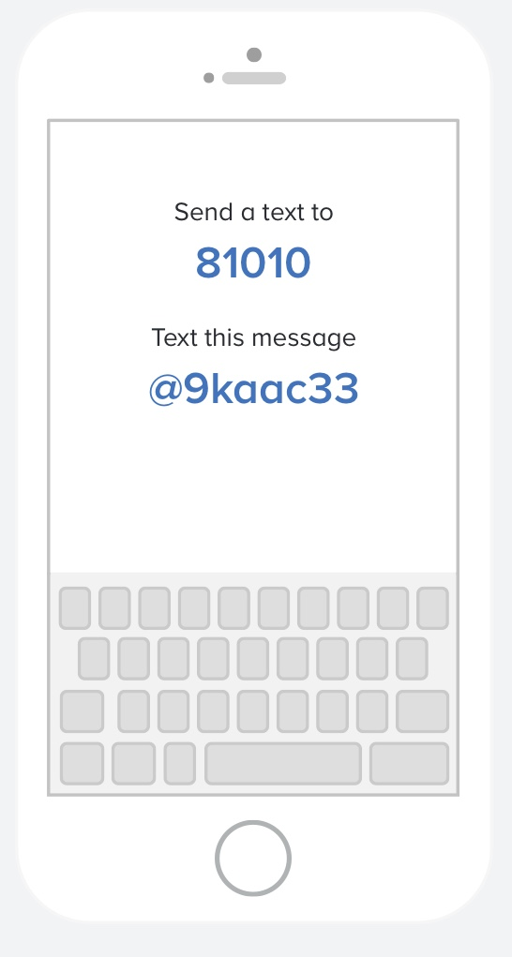
POLICIES
COURSE SYLLABUS | 2020-2021
LATE/MAKE-UP WORK POLICY
Students have 3 days to make up any missed assignments. Students are required to get their own make up work. I do not accept late work.
This policy may change due to COVID-19.
Join Remind
7th Grade Regular ELA: 7kk476
7th Grade AS ELA: 7thase
You can join by
texting 81010 followed
by the class code.
Remote Learners
Expectations:
Login to Schoology everyday and work on the assigned weeks work.
Complete each weeks assignments by the following Sunday at midnight. (ex: the week of 8/24 will be due Sunday 8/30).
Do not use materials (notes, books, phone, or other people) for tests and quizzes.
Communicate with me when you are have questions or issues.
Allow me 48 hours to respond to emails.
OTHER POLICIES
You may have bottled water in the classroom, but no food or drinks other than water.
No gum is allowed in school. It is an automatic write up.
Be on time to class. After four tardies it is an automatic write up.
You must have your planner to leave the classroom.
Come prepared to class with your materials and a positive attitude. This includes pencils or pen and paper.
Be respectful to everyone.
Clean up after yourself.
Phones are not allowed unless given permission by the teacher.
I do not allow students to go back to your locker, so make sure you have all materials with you.
Accelerated Reader
Student returning to school in person will go the the library once every other week. During library time you must check out a book to read during free time and at home.
Regular English classes will be required to complete one fiction and one non fiction book within your reading level.
Academic Scholars classes will be required to complete two fiction and one non fiction book within your reading levels.
All students must make a 60% or higher on your AR tests to get the 100 for the grade each 9 weeks.
EPIC
Those who are doing remote learning. Epic is available to read or listen to books.
The class code is mdz6390

